Slide 1

Software Design & Analysis
Why Software Engineering?
Course Code: CS3004
Credit hours: 3

Slide 2
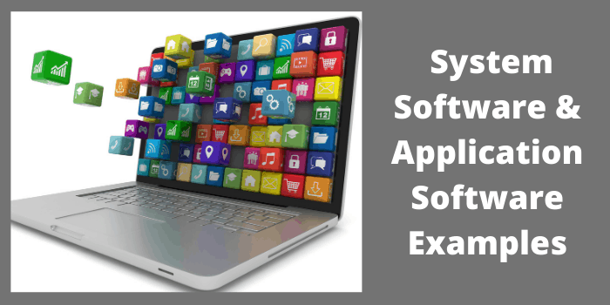
Why Software Engineering? – Software Systems Applications

Slide 3
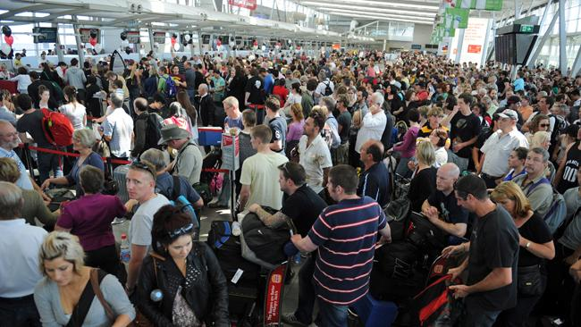
Why Software Engineering? – Software Crisis
Example 1: 2009,Computer glitch delays flights
Saturday 3rd October 2009-London, England (CNN)
Dozens of flights from the UK were delayed Saturday after a glitch in an air traffic control system in Scotland, but the problem was fixed a few hours later.
The agency said it reverted to backup equipment as engineering worked on the system.
The problem did not create a safety issue but could cause delays in flights.
Read more at:
http://edition.cnn.com/2009/WORLD/europe/10/03/uk.flights.delayed

Slide 4
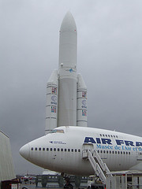
Why Software Engineering? – Software Crisis
Example 2: Ariane 5 Explosion
European Space Agency spent 10 years and $7 billion to produce Ariane 5.
Crash after 36.7 seconds.
Caused by an overflow error. Trying to store a 64-bit number into a 16-bit space.
Watch the video: http://www.youtube.com/watch?v=z-r9cYp3tTE
Notes:
Data type mismatches worsened the condition, reuse of legacy software system from Ariane 4

Slide 5
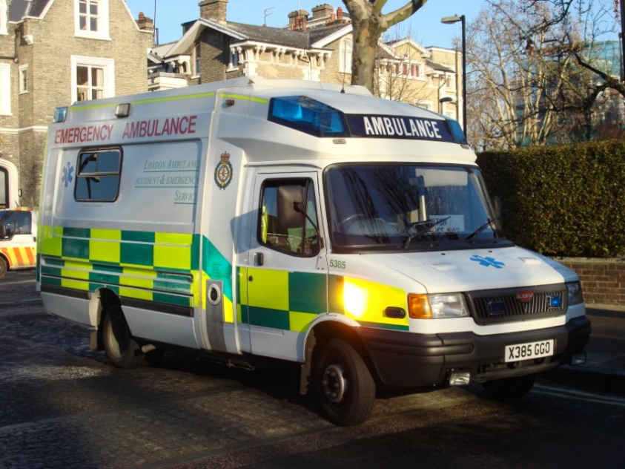
Why Software Engineering? – Software Crisis
Example 3: 1992, London Ambulance Service
Considered the largest ambulance service in the world.
Overloaded problem.
It was unable to keep track of the ambulances and their statuses. Sending multiple units to some locations and no units to other locations.
Generates many exceptions messages.
46 deaths.
Notes:
Load balancing

Slide 6
Example case studies of software crisis
Y2K Bug: Discuss the potential consequences of this millennium bug and how it was averted through extensive software engineering efforts.
Therac-25: Analyze the medical device failures caused by software errors and the importance of rigorous testing and quality assurance.
Autonomous Vehicle Accidents: Explore the challenges of developing safe and reliable self-driving car software.
Data Breaches: Discuss the impact of software vulnerabilities on individuals and organizations, and the role of software engineers in preventing them.
Notes:
Years were stored as 2 digits 96 rather than 1996. Banking misinterpretations, Air traffic system might fail due to misinterpretations. Future proofing system design
Comp radiation therapy machine.overdose of radiation
Sensor failures, decision making errors
Loss of personal data, theft and fraud, financial penalties for companies

Slide 7
Why Software Engineering?
Therefore…
A well-disciplined approach to software development and management is necessary. This is called engineering.

Slide 8
What is Software Engineering?
The term software engineering first appeared in the 1968 NATO Software Engineering Conference and was meant to provoke thought regarding what was then called the “software crisis”..
An engineering discipline that is concerned with all aspects of software production from the early stages of system specification to maintaining the system after it has gone into use. (Sommerville)
Software engineering is about the creation of large pieces of software that consist of thousands of lines of code and involve many person months of human effort. (Douglas Bell)

Slide 9
What is Software Engineering?
Software engineers apply the principles and techniques of computer science, engineering, and mathematical analysis to the design, development, testing, and evaluation of the software and the systems that enable computers to perform their many applications.
Software engineers must possess programming skills, but are often more concerned with developing algorithms and analyzing and solving programming problems than with actually writing code.
Notes:
Software engineer must …

Slide 10
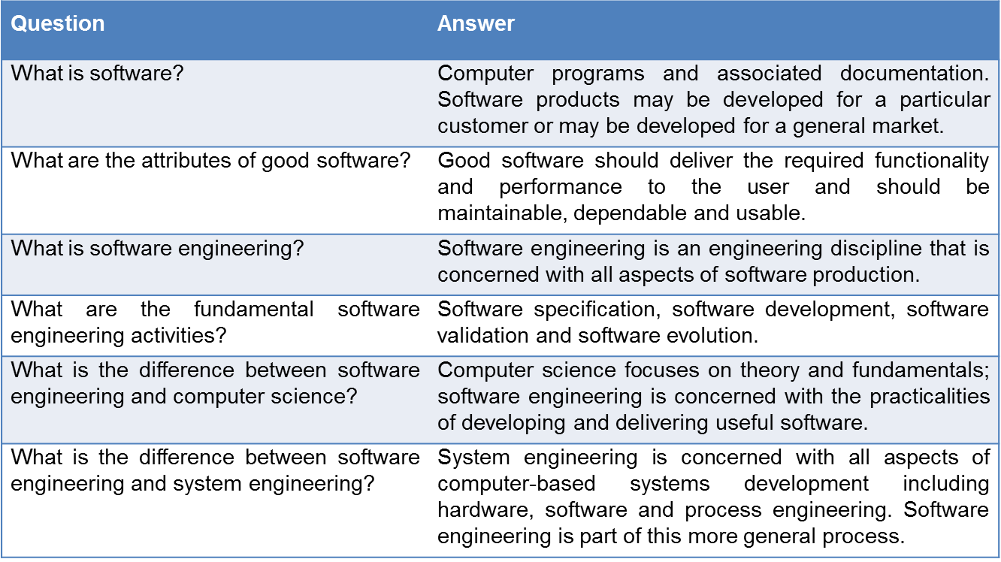
FAQ about SE

Slide 11
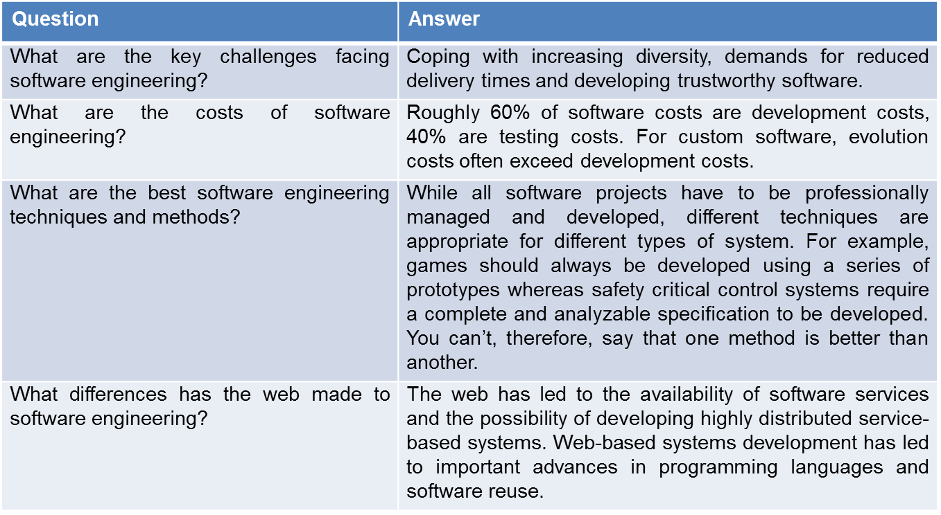
FAQ about SE
Notes:
Changine in technology, budget and time short, evolving user requirement, quality assurance, security
Dev, maintaining, training,q\ulaity assurance costs

Slide 12
Software Engineering Diversity
Stand-alone applications
Office applications
Interactive transaction-based applications
E-commerce systems
Embedded control systems
Mobile phones
Batch processing systems
Phone billing systems
Entertainment systems
Games
Modelling and simulation systems
Visio
System of systems
ERP systems

Slide 13
Software Engineering Goals
Meeting users’ needs
Low cost of production
High performance
Portability
Low cost of maintenance
High reliability
Delivery on time

Slide 14
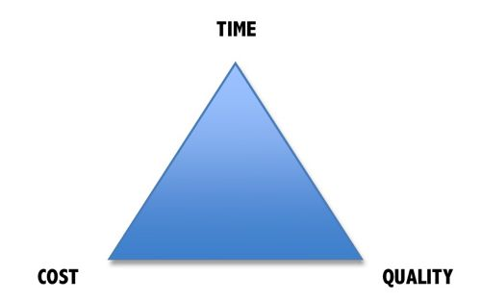
Software Success/Failure Parameters

Slide 15
Data on Project Development Success and Failures
A study by the Standish Group 1995 reports that:
In USA, $250 billion spent each year on IT application development of approximately 175,000 projects.
52.7% of projects were finished but exceeded the estimated budget by up to 189%.
On average only 42% of the planned system functionalities were implemented.
31.1% of projects were cancelled and did not deliver the desired results
Only 16.1% of the projects were finished on time, within budget, and realized all the planned system functions
Notes:
28175

Slide 16
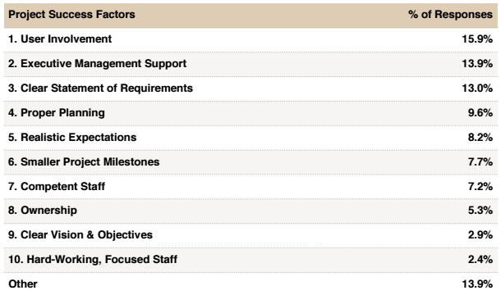
Project Success Factors

Slide 17
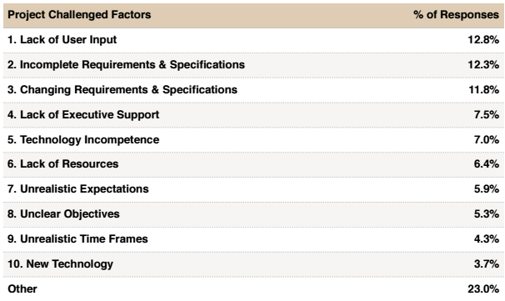
Factors impacting Projects Challenges

Slide 18
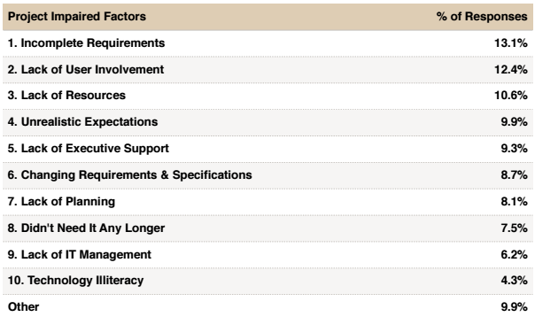
Factors impacting Projects Impaired

Slide 19
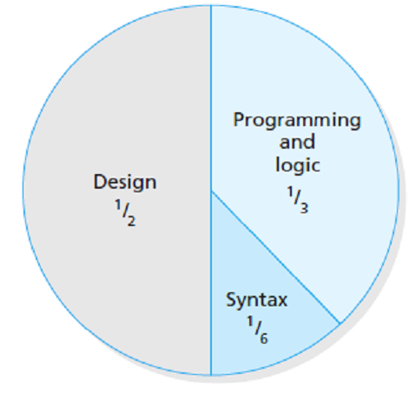
Software Development – Time Analysis

Slide 20
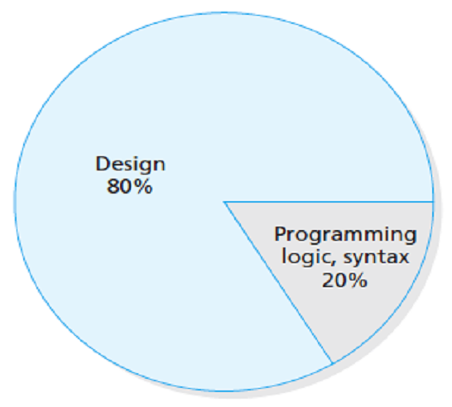
Cost of Fixing Faults

Slide 21
